Slide 1
Instructions for Local Chapter Newsletter – Template The attached powerpoint template is an editable newsletter that you can use to keep your members updated with the latest chapter news. Replace images and text with your chapter information. Exporting powering as pdf: Go to FILE Select EXPORT > PDF Use these same steps to save as jpeg for email use. Importing images into body of email In your email, select the image icon, not the paperclip icon. After selecting the image icon, you will have the option to select a jpeg file. Choose your images that you have saved from your powerpoint template. You want to do this as well as add the pdf as an attachment just in case the recipient cannot view your images. Composing your email Use Tile Case and 5 words or less in your email subject line. In your body copy, briefly summarize what the content is about. Remind them that they are receiving these emails because they are VAREP members. Be sure to include a call to action e.g. Volunteer today, sign up for our mixer, Register for our golf tournament or include a video link of our latest home donation. Please feel free to reach out to National if you have any questions Jlopez@varep.net or 851-444-7363 Thank you VAREP Board of Directors for all that you do. #VAREPStrong

Slide 2









Monthly varep (location) chapter
Your 2020 VAREP (Local Chapter) board of directors:
A LETTER FROM THE CHAPTER PRESIDENT
UPCOMING EVENTS:
The VAREP San Bernardino Chapter is in full swing in 2020. Check out what we’ve been up to so far and the things on tap for the rest of the year. We would love for you to join us in serving our servicemen and servicewomen.
Who we are:
Established in 2011 (San Bernardino Chapter in April 2013), the USA Homeownership Foundation, Inc. DBA Veterans Association of Real Estate Professionals (VAREP), is a non-profit 501(c)(3) organization dedicated to increasing sustainable housing, financial literacy education, VA benefits awareness, and economic
opportunity for the active-military
and veteran communities.
Lunch and learn
January 12, 2020 - 11am - 12pm
123 Main St., Suite 110
Fontana, CA 12345
Lunch and learn
January 12, 2020 - 11am - 12pm
123 Main St., Suite 110
Fontana, CA 12345
Lunch and learn
January 12, 2020 - 11am - 12pm
123 Main St., Suite 110
Fontana, CA 12345
Lunch and learn
January 12, 2020 - 11am - 12pm
123 Main St., Suite 110
Fontana, CA 12345

Slide 3


EVENT RECAP
The VAREP Honolulu Stars & Stripes Golf Tournament on April 27 was a
great success, thanks to great sponsors like:
• Guild Mortgage
• Freedom Mortgage
• Stearns Lending
• JN Chevrolet
Proceeds went to support
• Mo’s Heroes homeless veterans initiatives
• Army Fisher House at Tripler Hospital’s combat-wounded programs
• VAREP Vet Education objectives
Captain James Harbin, Purple Heart recipient, inspired the banquet crowd
with stories from the battlefield.

Slide 4
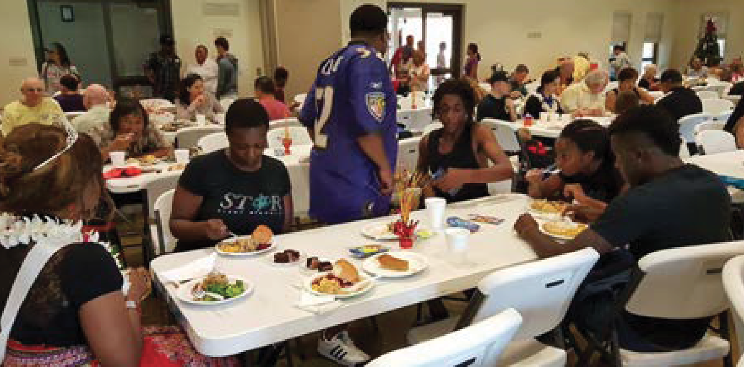

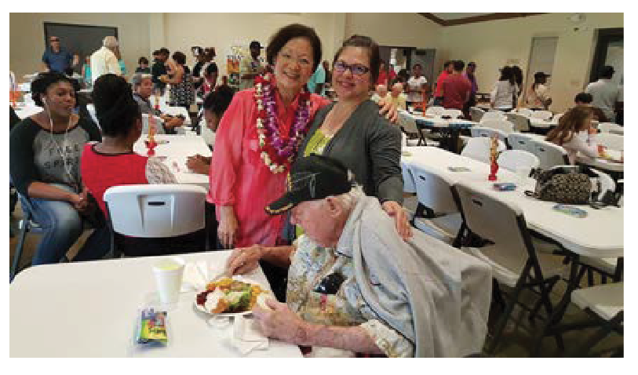
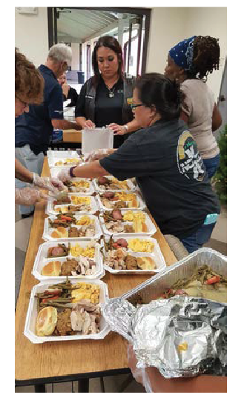
You Made VAREP cares
possible this holiday!
Teaming up once again for the annual Koa Ohana Thanksgiving
Luncheon at the Oahu Veterans Center on November 23.
Providing food, fellowship and fun for our homeless veterans and those who would otherwise not have a Thanksgiving meal.
If you would like to volunteer for upcoming events, please email
chapter@varep.net

